Slide 1
2D String Array
ELEC1006: ENGINEERING COMPUTING

Slide 2

2D String Array
Use a two-dimensional array of characters as an array of strings: const int NAMES = 3, SIZE = 10; char students[NAMES][SIZE] =
{ "Ann", "Bill", "Cindy" };
Each row contains one string
Can use row subscript to reference the string in a particular row:
cout << students[i];
PAGE 2

Slide 3
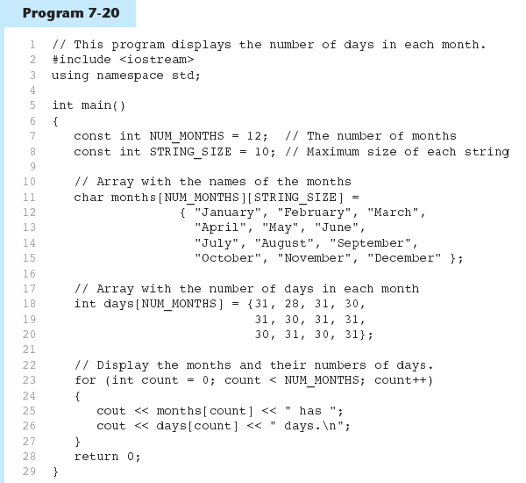
Example 1
PAGE 3

Slide 4
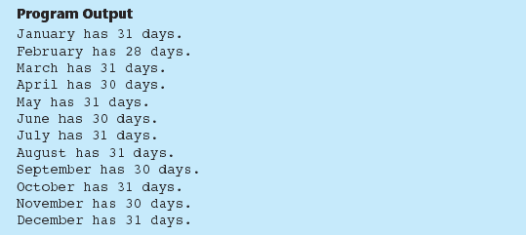
Example 1 Output
PAGE 4

Slide 5
More info
[1] cplusplus.com: Arrays
https://www.cplusplus.com/doc/tutorial/arrays/
[2] leanrcpp.com: 6.1 – Arrays (Part I) https://www.learncpp.com/cpp-tutorial/61-arrays-part-i/
[3] learncpp.com: 6.2 – Arrays (Part II)
https://www.learncpp.com/cpp-tutorial/62-arrays-part- ii/
[4] learncpp.com: 6.3 – Arrays and loops
https://www.learncpp.com/cpp-tutorial/63-arrays-and- loops/
PAGE 5

